Slide 1



Spectral Analysis of Lithium, Beryllium and Boron Nuclides with DAMPE
Zhan Fang Chen*, Andrea Parenti, En Heng Xu, Chuan Yue
on behalf of the DAMPE collaboration
*email:chenzf@impcas.ac.cn

Slide 2
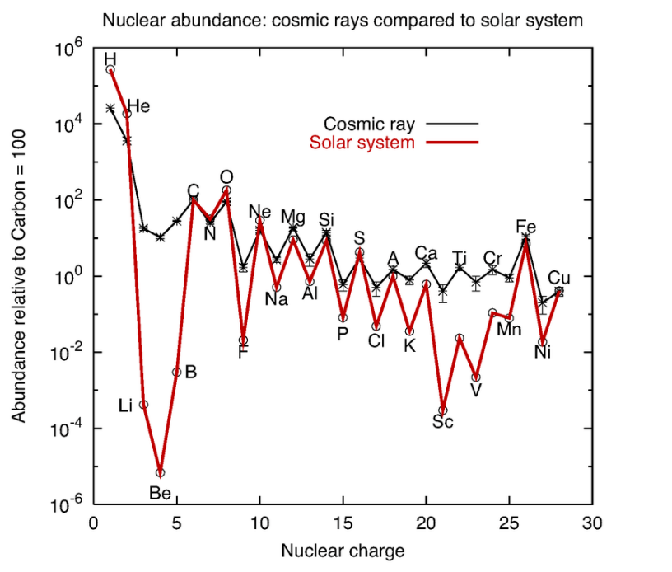
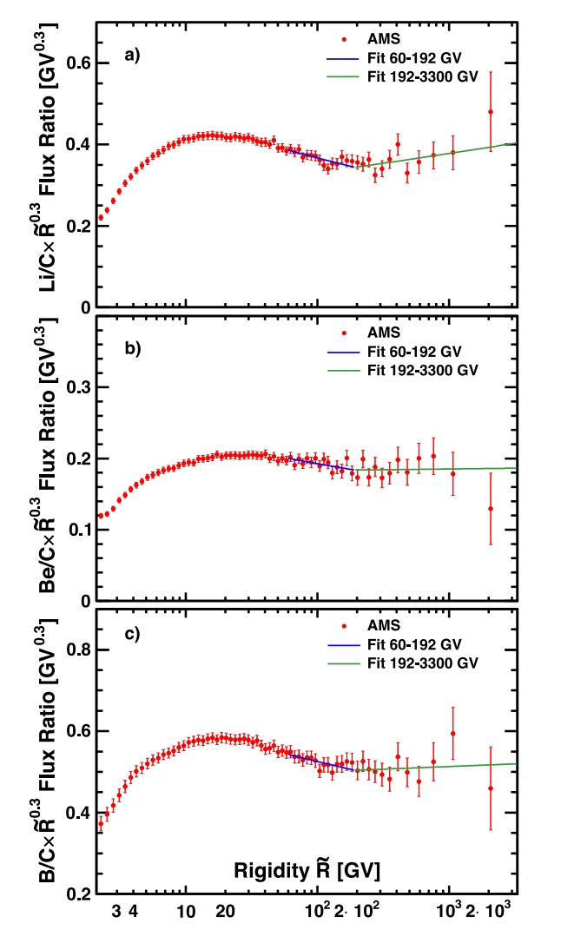
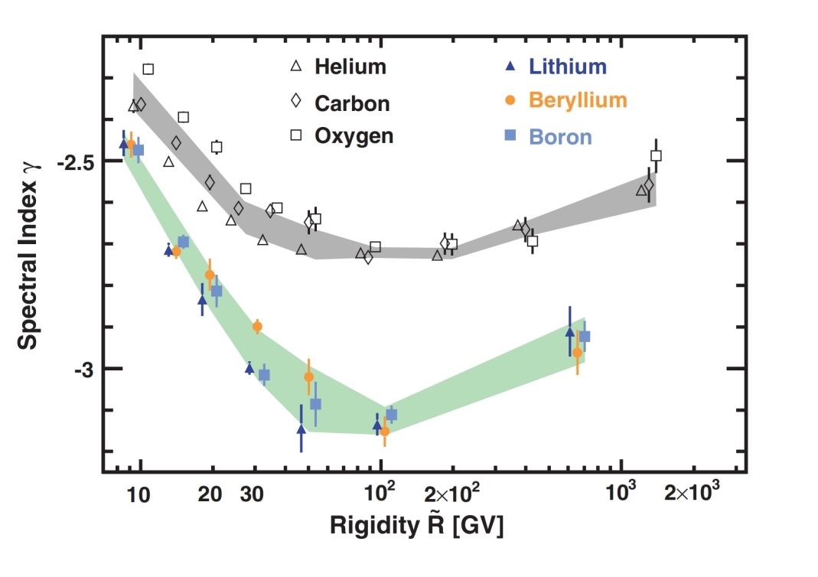
Primary/Secondary cosmic rays
(Mehrez et. al. 2015)
Lithium, Beryllium, and Boron in Cosmic Rays
  Mainly produced by fragmentation of heavier nuclei (e.g., C and O)
  Much higher abundances in Cosmic Rays (CRs) compared to the solar system
  Precise Li(Be)/C flux ratio measurements are crucial for understanding CR propagation
(AMS collaboration 2021)

Slide 3
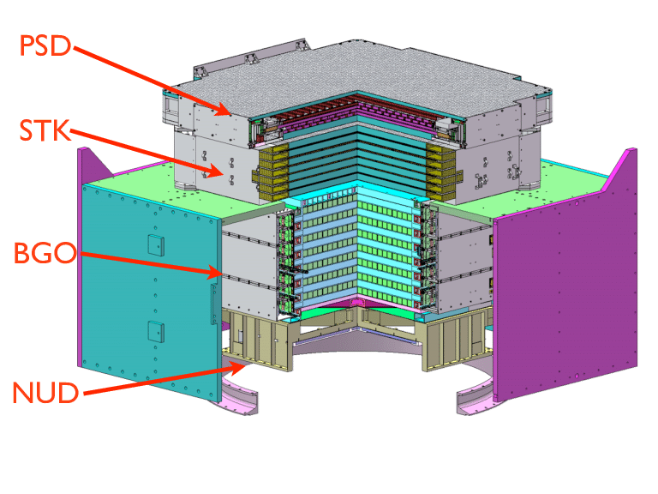
The DAMPE detector
Plastic Scintillator Detector (PSD):
  Charge measurement
  Photon anti-coincidence
Silicon Microstrip Tracker (STK):
  Charge measurement,
  Track measurement
Bismuth Germanate (BGO) Calorimeter:
  Energy measurement
  Lepton/hadron identification.
Neutron Detector (NUD):
  High-energy lepton
  Hadron identification.
Advantages: Optimal energy resolution, leading particle identification, excellent angular resolution

Slide 4
PreSelction
Preselection:
  Exclude events from the SAA region: where the detector operates anomalously.
  High-energy trigger: Ensure reliable interactions between cosmic ray particles and detector materials.
  Energy deposition above 50 GeV: Minimize the effects of geomagnetic cutoff.
  The main axis of the shower should be within the BGO calorimeter as much as possible.
Flight Data
  8 years（2016-2023）
  Live Time:1.92×10⁸ seconds
Simulation
  Energy：10GeV-500TeV
  Sampe：
    Li6:Li7=1:1
    Be7:Be9:Be10=5:3:2
    B10:B11=3:7
  Physical Model：
    GEANT4v4.10.5（FTFP_BERT and EPOS-LHC）

Slide 5
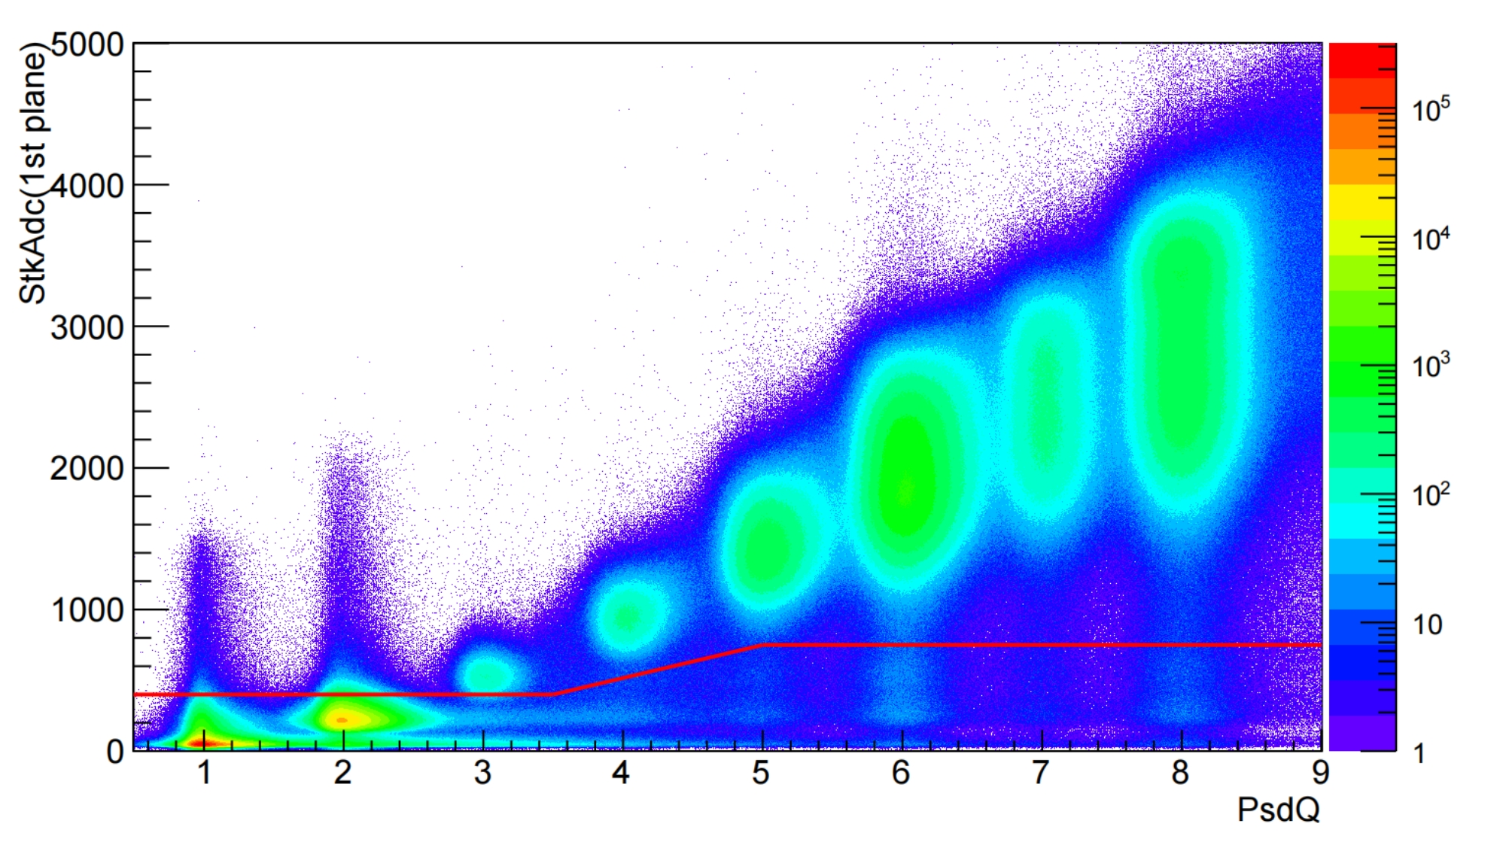
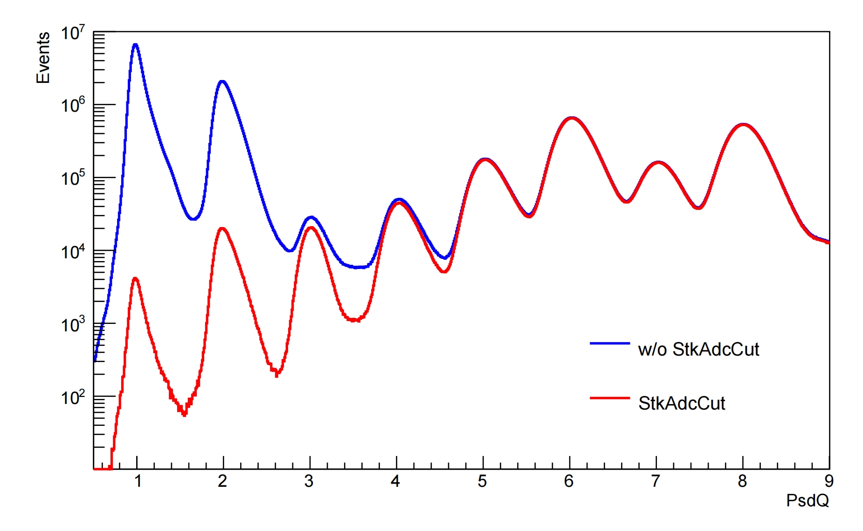
STK charge selection
Contamination Reduction:
  Use the charge deposit in first STK plane to reduce p, He contamination.
  Li/Be/B: STK charge X/Y layer 0 > 400 ADC.

Slide 6
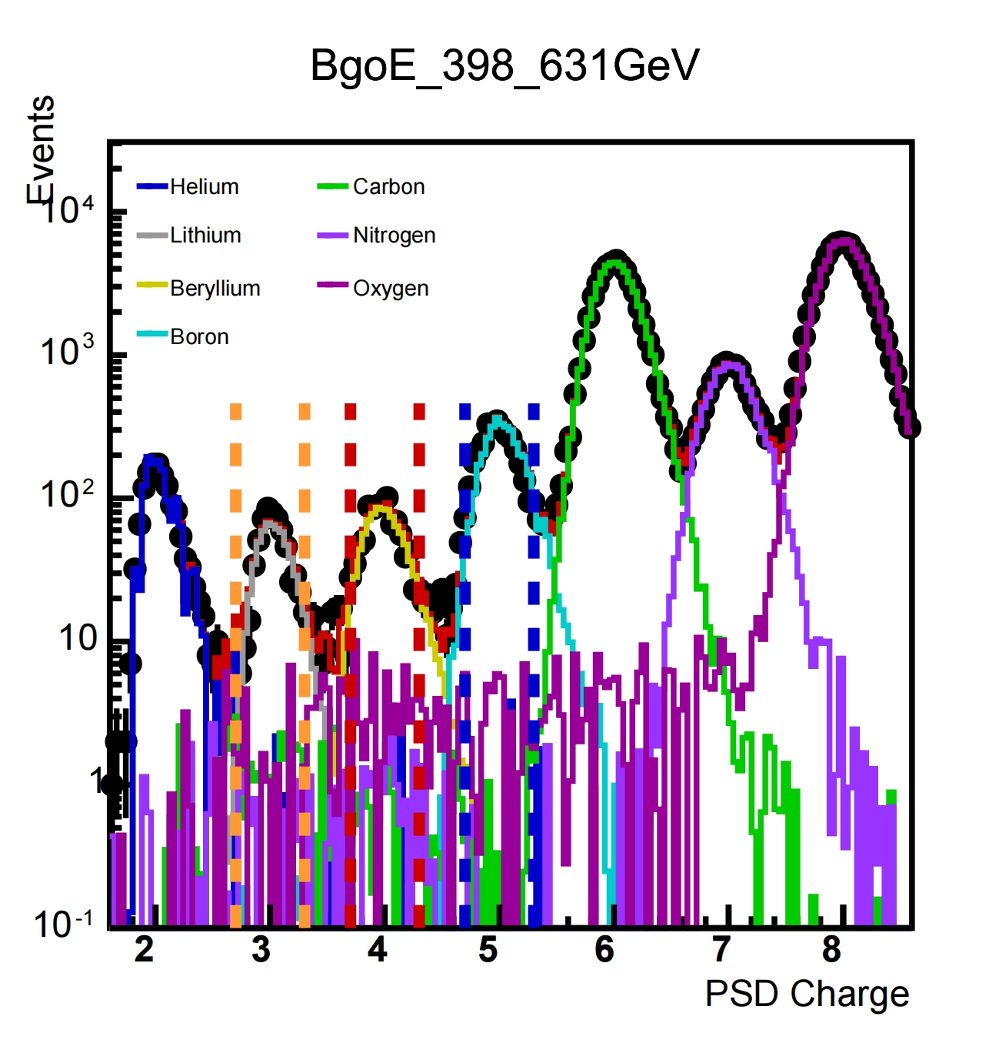
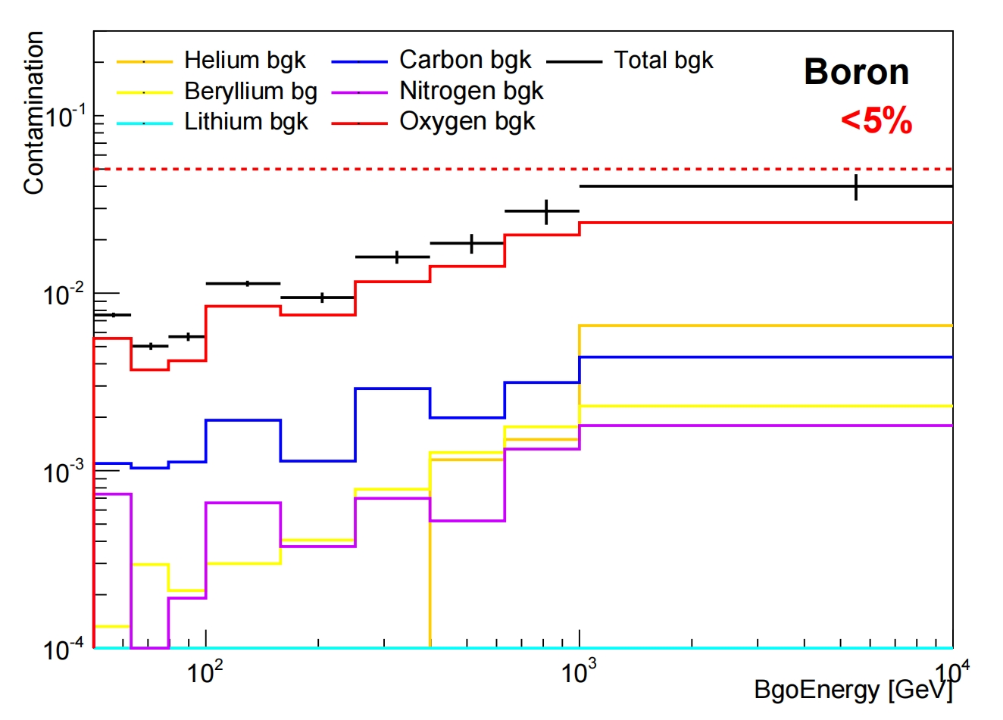
Background estimation
MC Template Fit:
  Performed with elements He to O.
  Estimated background fraction in E_{Bgo} bins (50 GeV to 10 TeV).
Contamination: Boron contamination by nearby nuclides is under 5%.

Slide 7
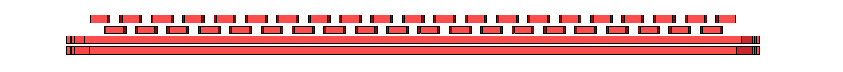
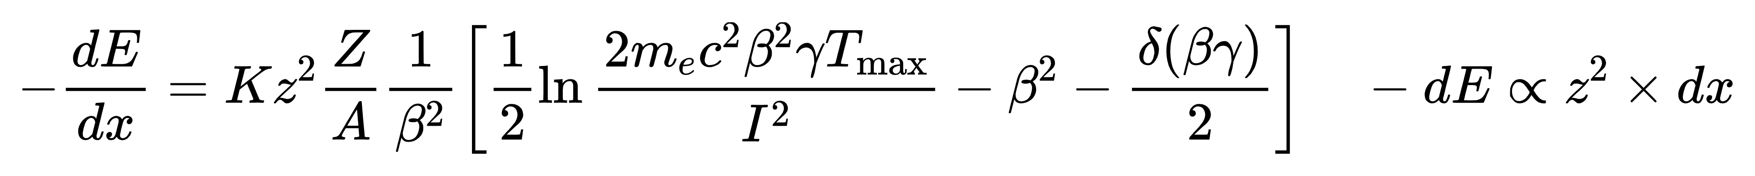
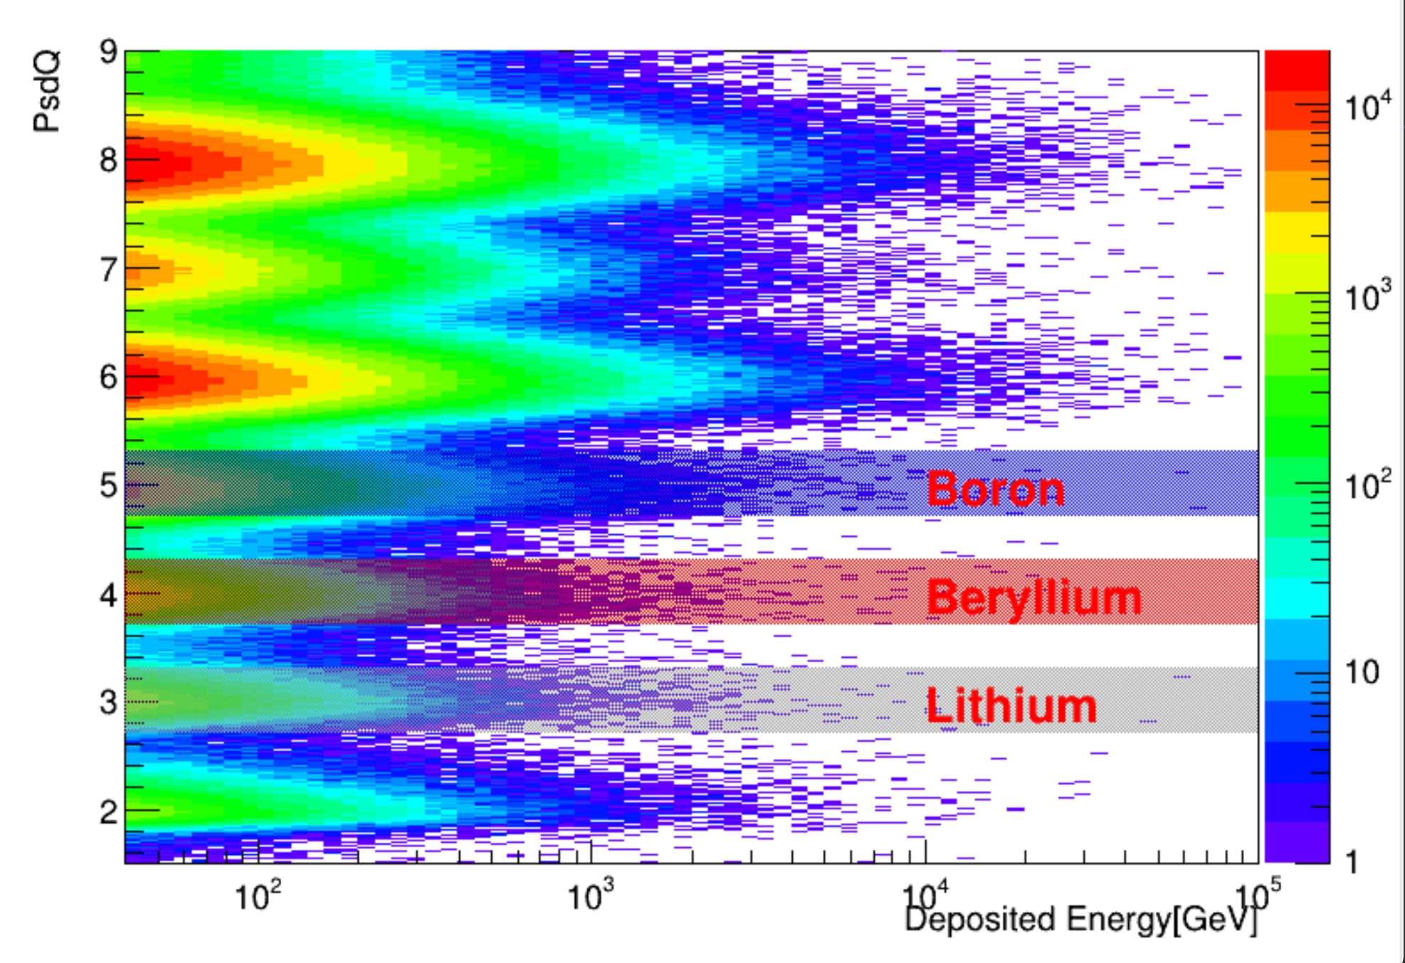
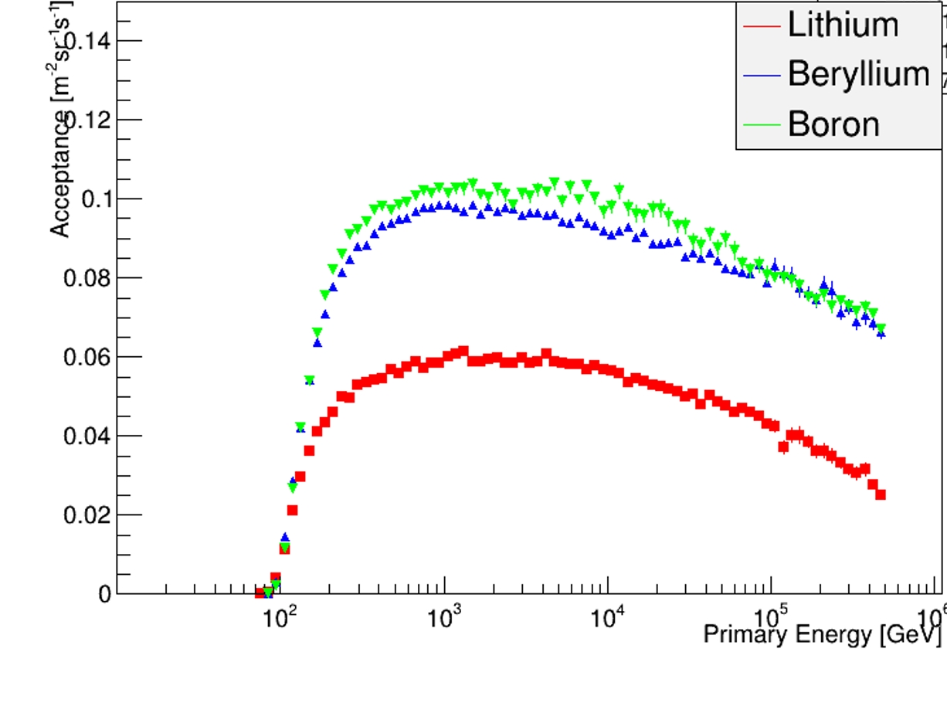
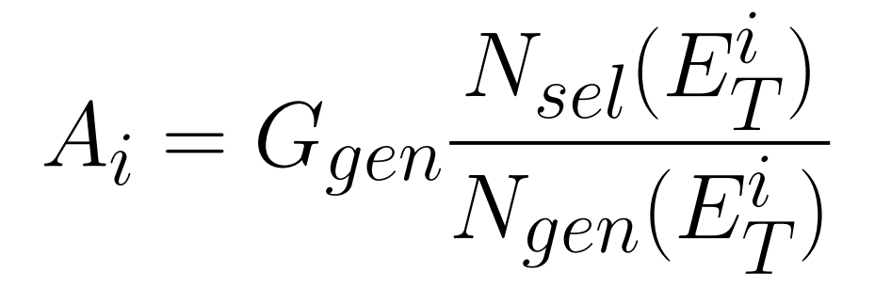
Charge Selction and Acceptance
Acceptance
Charge energy-Independence
MC charge smearing correction
Charge selection :
  Lithium selection:2.7<Z<3.3
  Berylium selection:3.7<Z<4.3
  Boron selection:4.7<Z<5.3

Slide 8
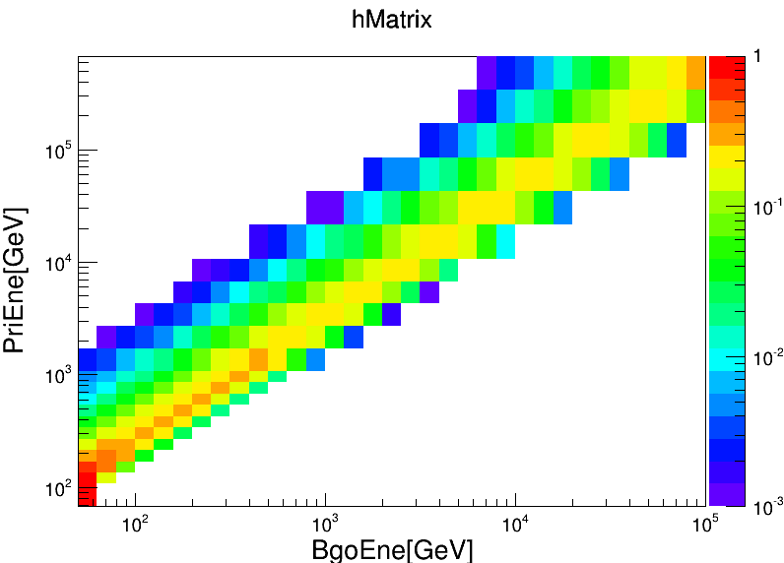
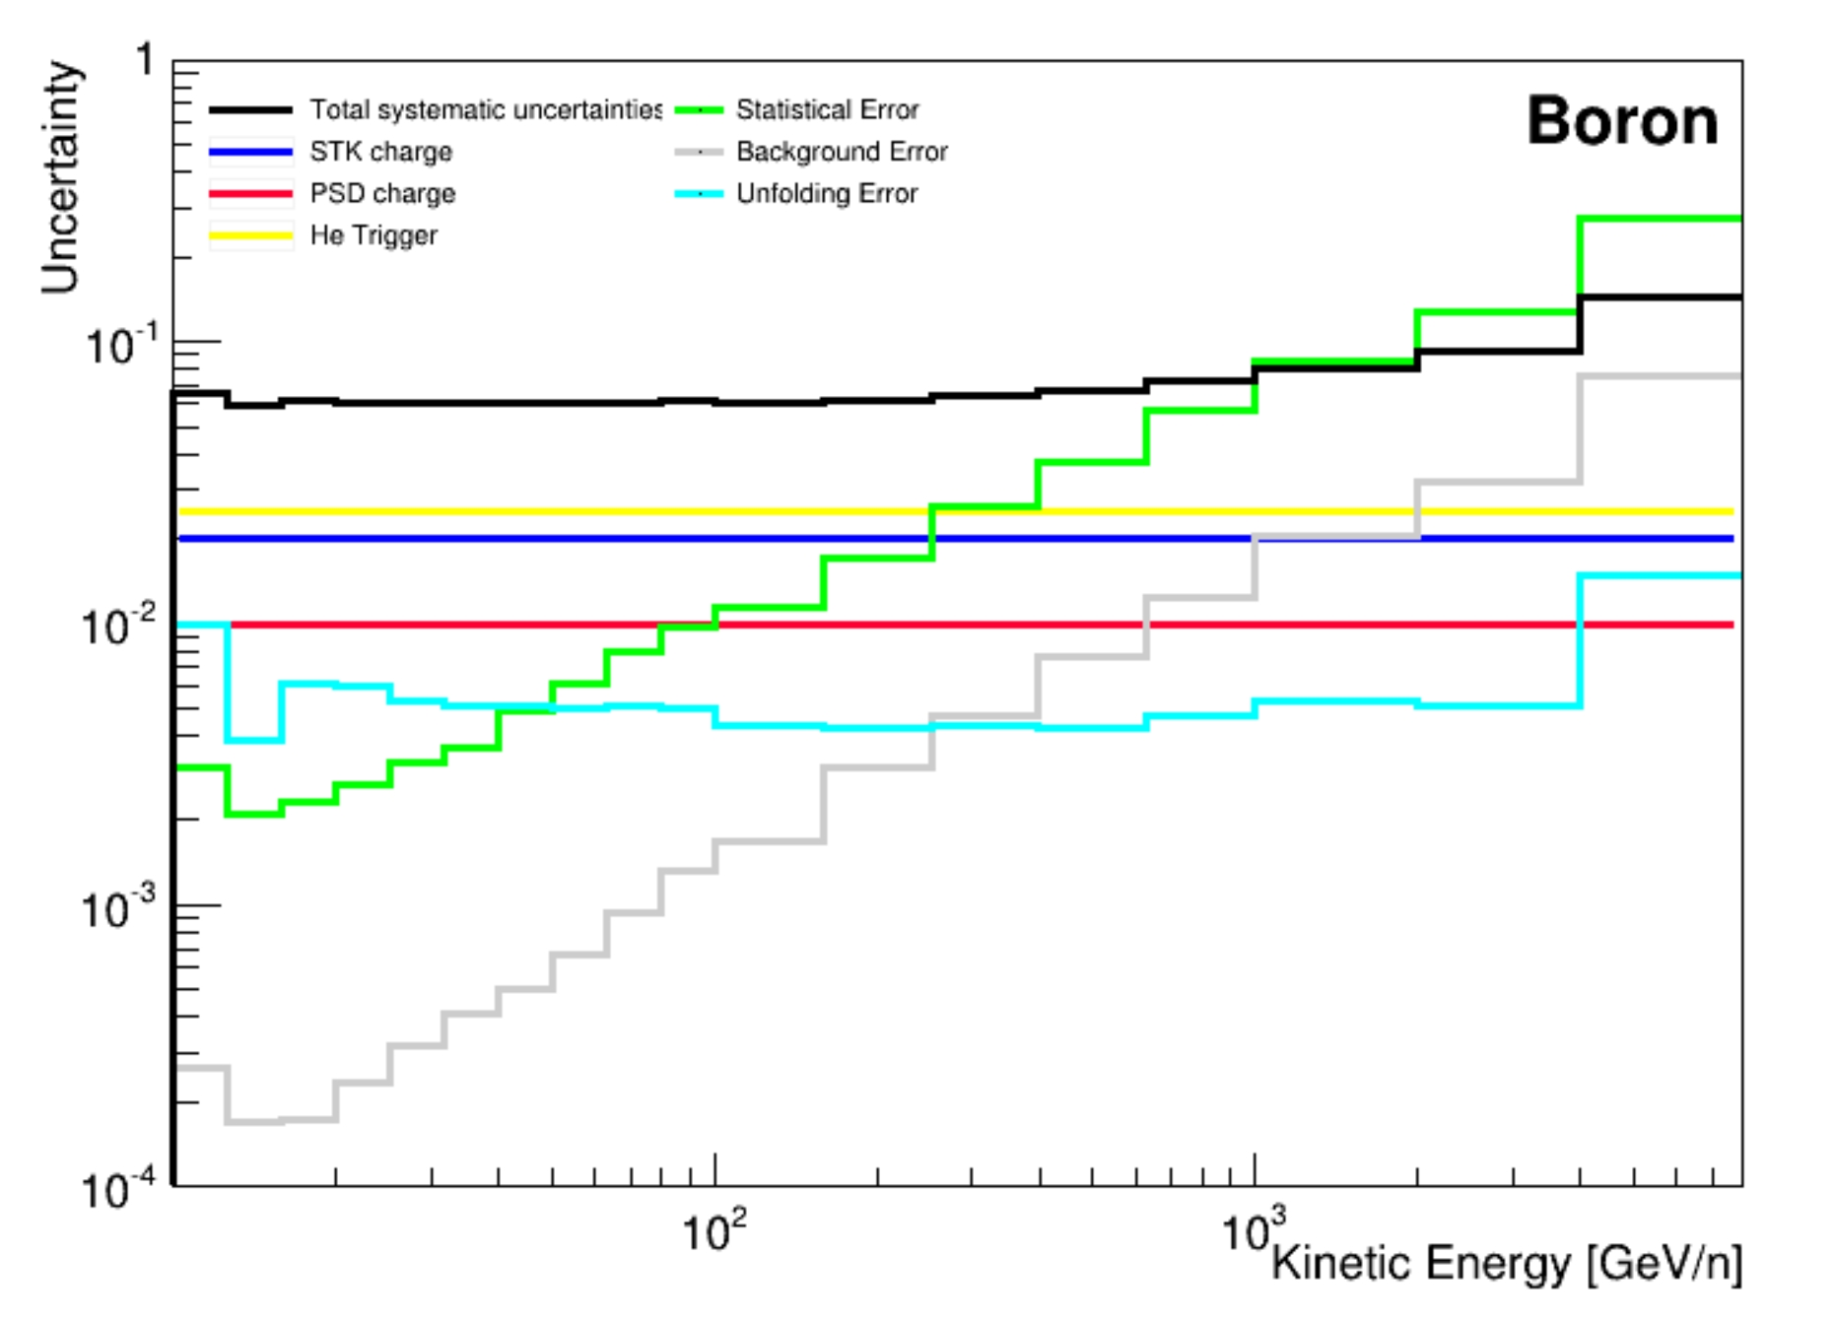
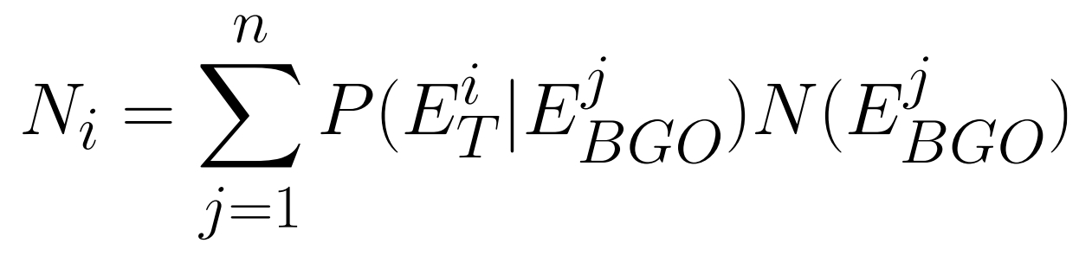
Unfolding and uncertainty estimation
Iterative Bayesian procedure is adopted to reconstruct the primary energy of the events:
Statistical uncertainty dominant at higher energies
Many systematical contributions evaluated:
  Background, Unfolding
  Cuts efficieney validated with flight data

Slide 9
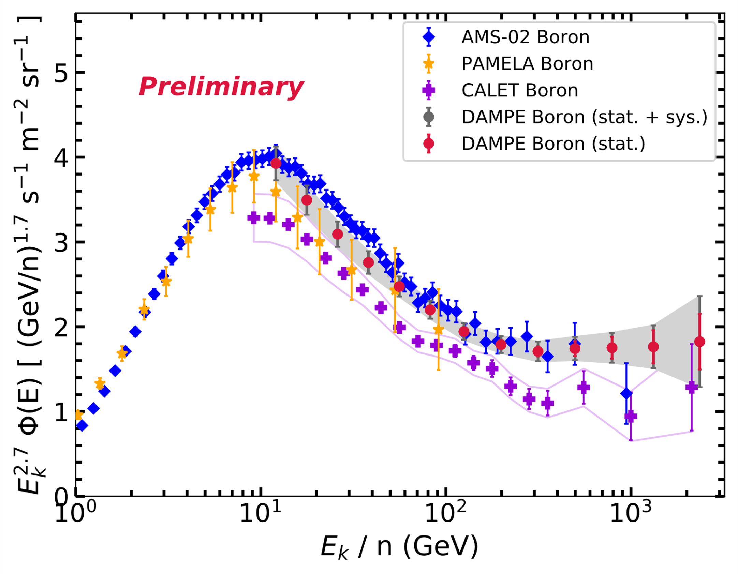
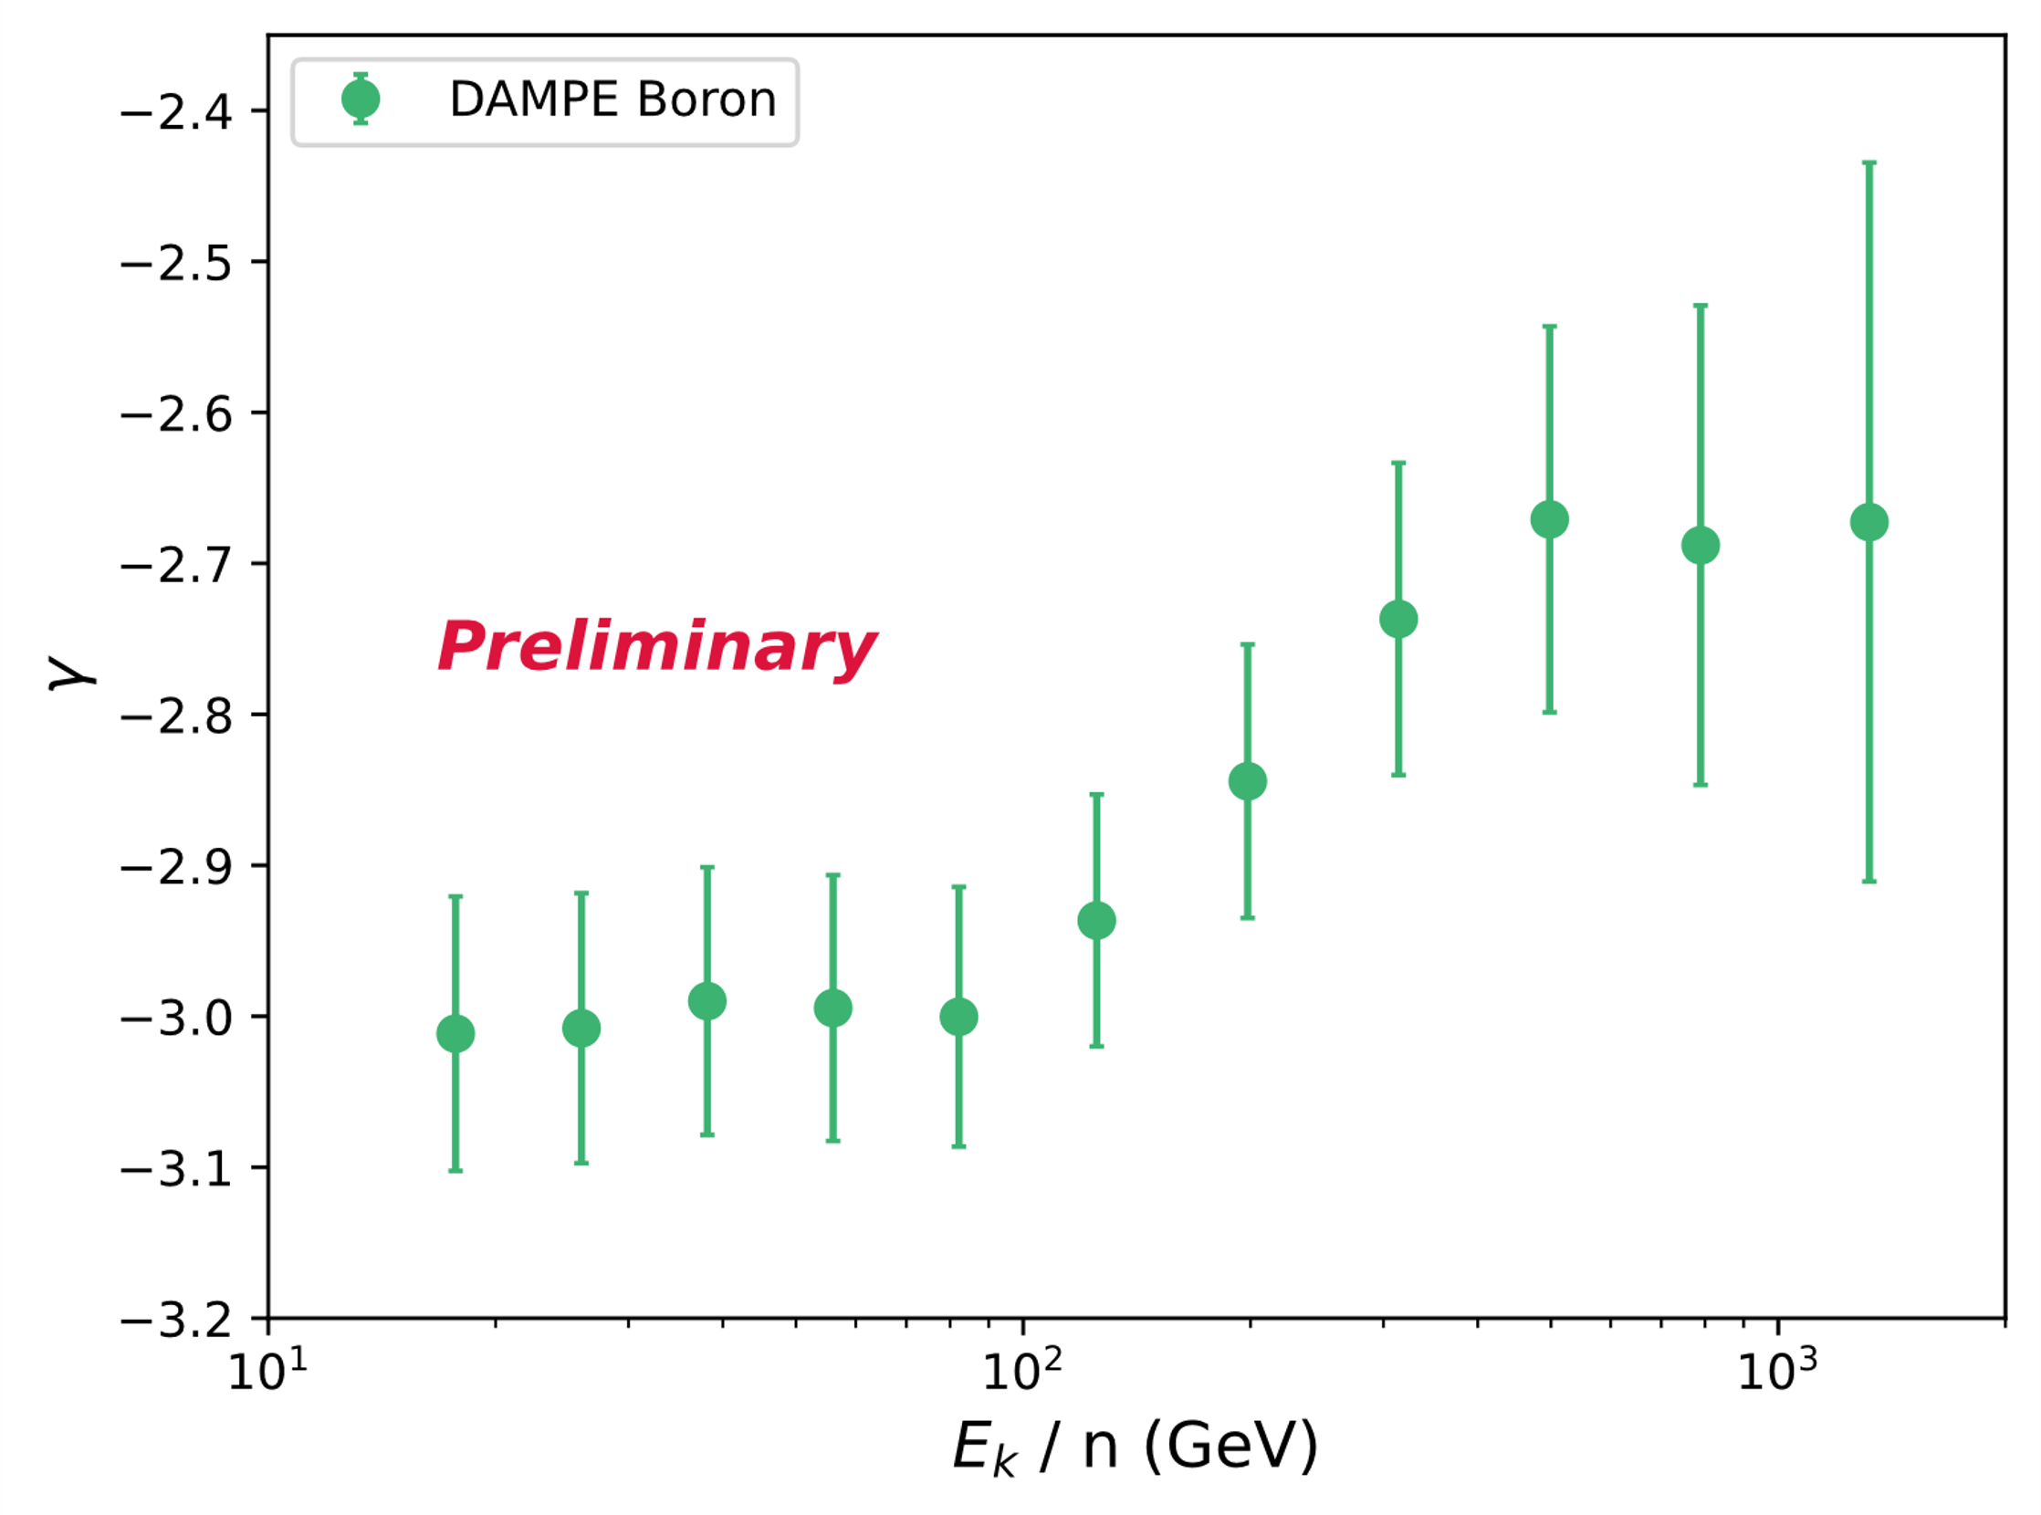

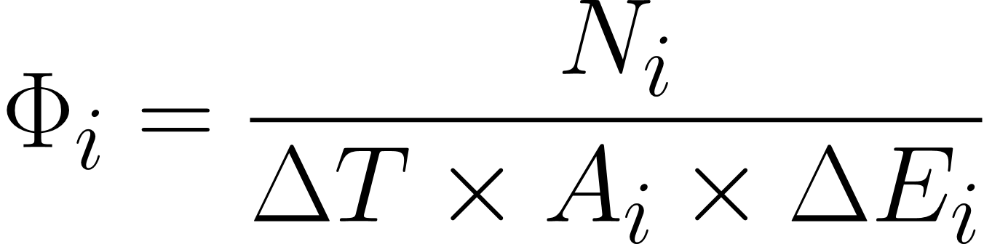
Boron flux
B10 : B11 = 3 : 7
MC GEANT4 FTFP_BERT
Differential flux is computed as:
DAMPE measured boron flux from 10 GeV/n to 3.2 TeV/n.
Spectral index hardening from –3.0 to –2.7 at a few hundred GeV/n.

Slide 10
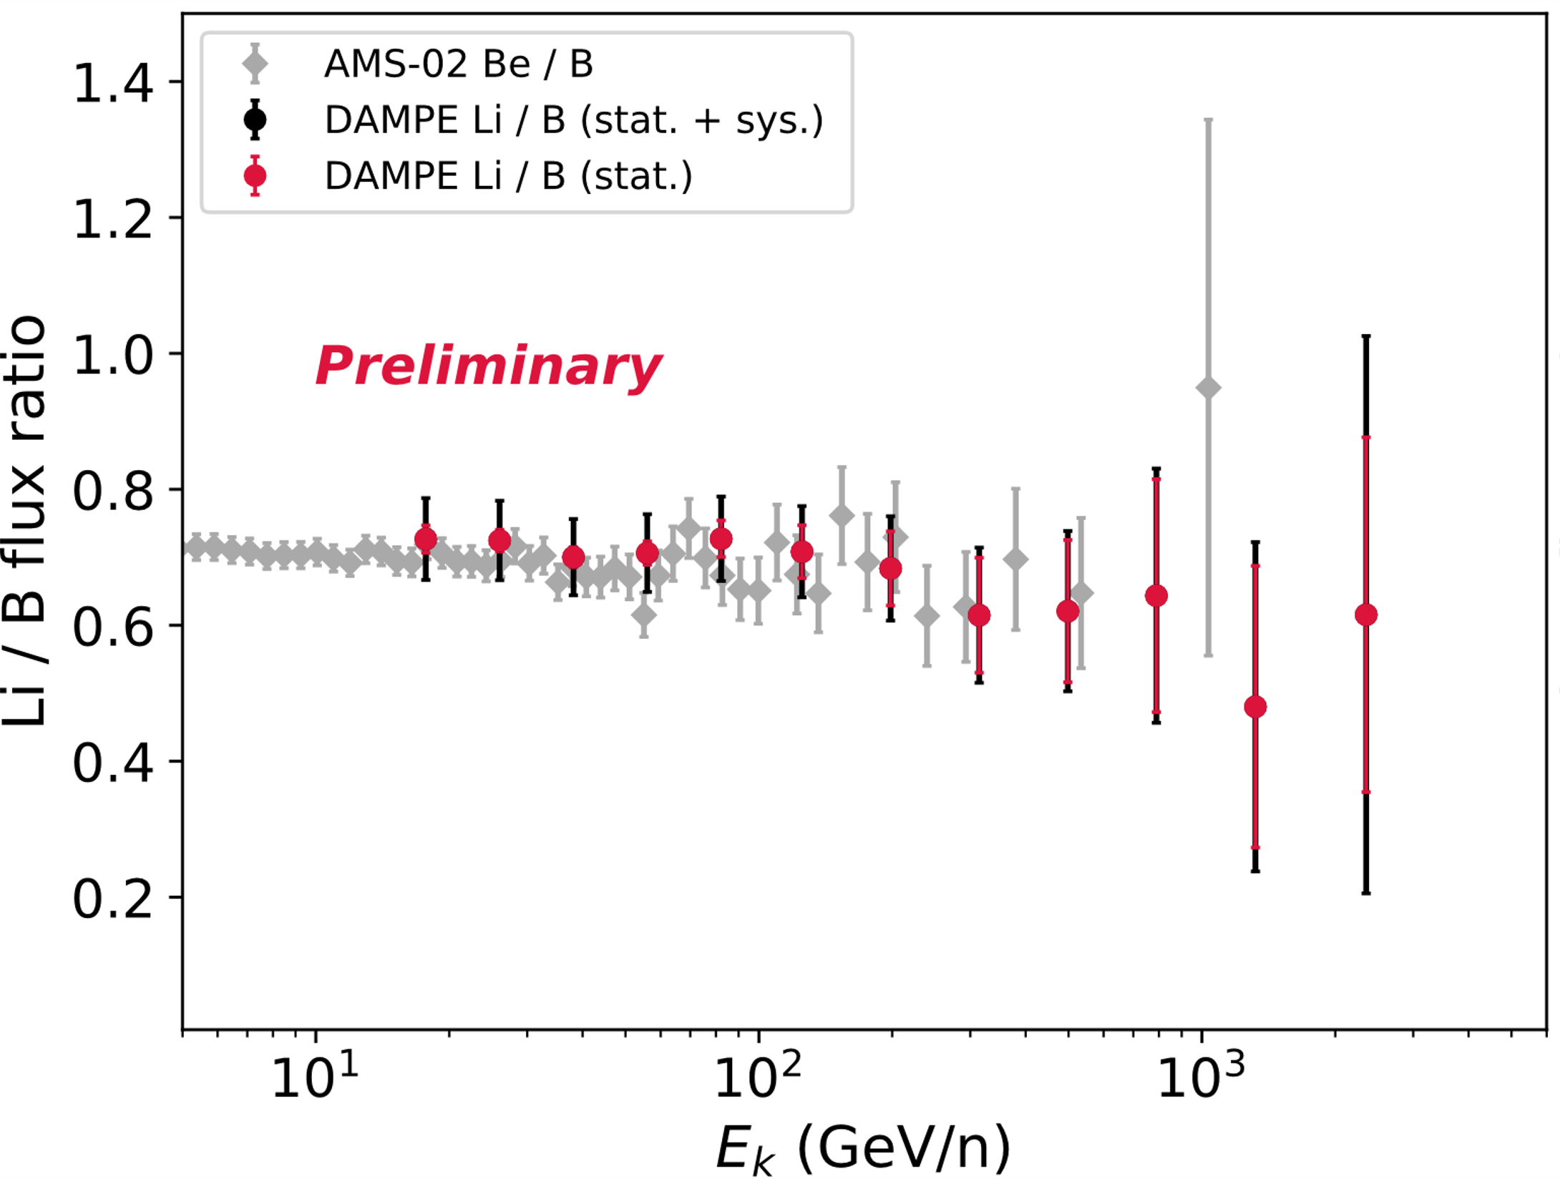
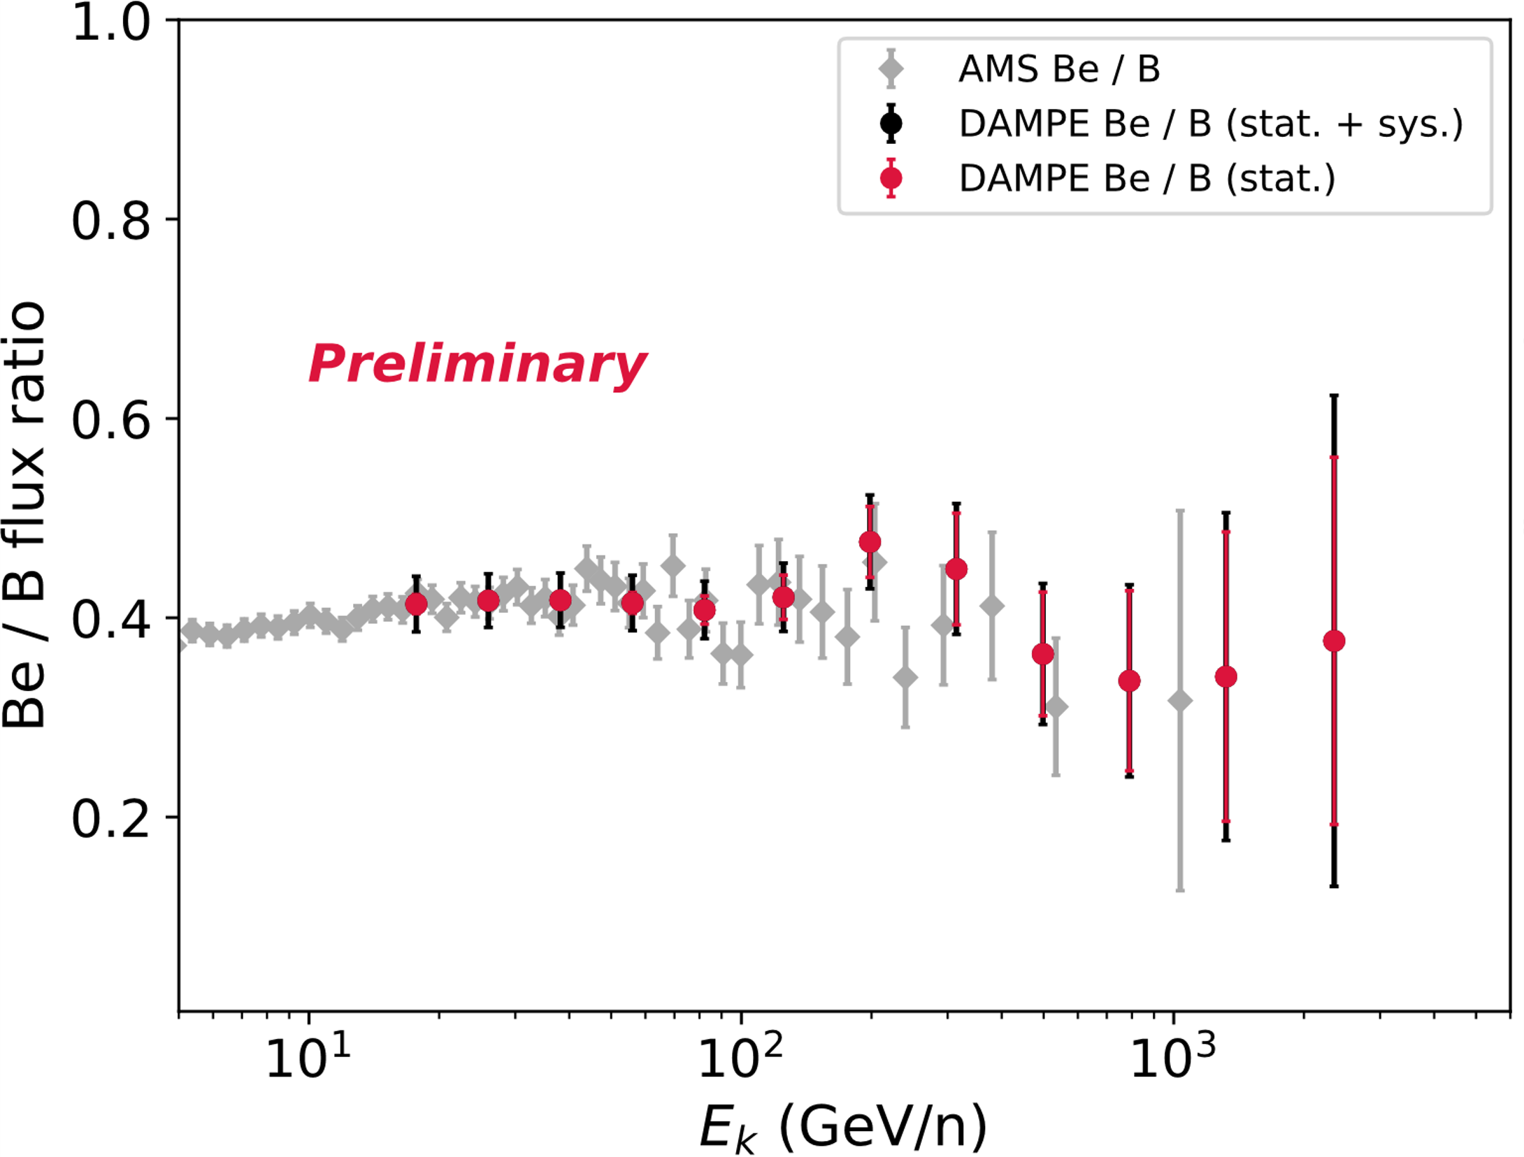
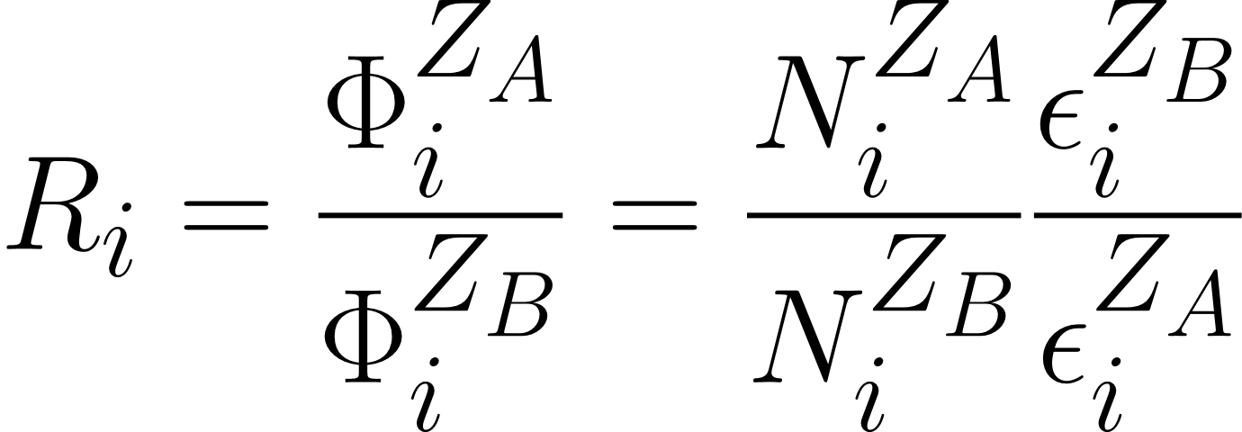
Flux ratios
Li6: Li7 = 1 : 1
    Be7:Be9:Be10=5:3:2
Preliminary measurement of Li/B and Be/B from 14.7 GeV/n to 3.2 TeV/n
Preliminary estimation of systematic uncertainty
Further reduction of the background is in progress

Slide 11
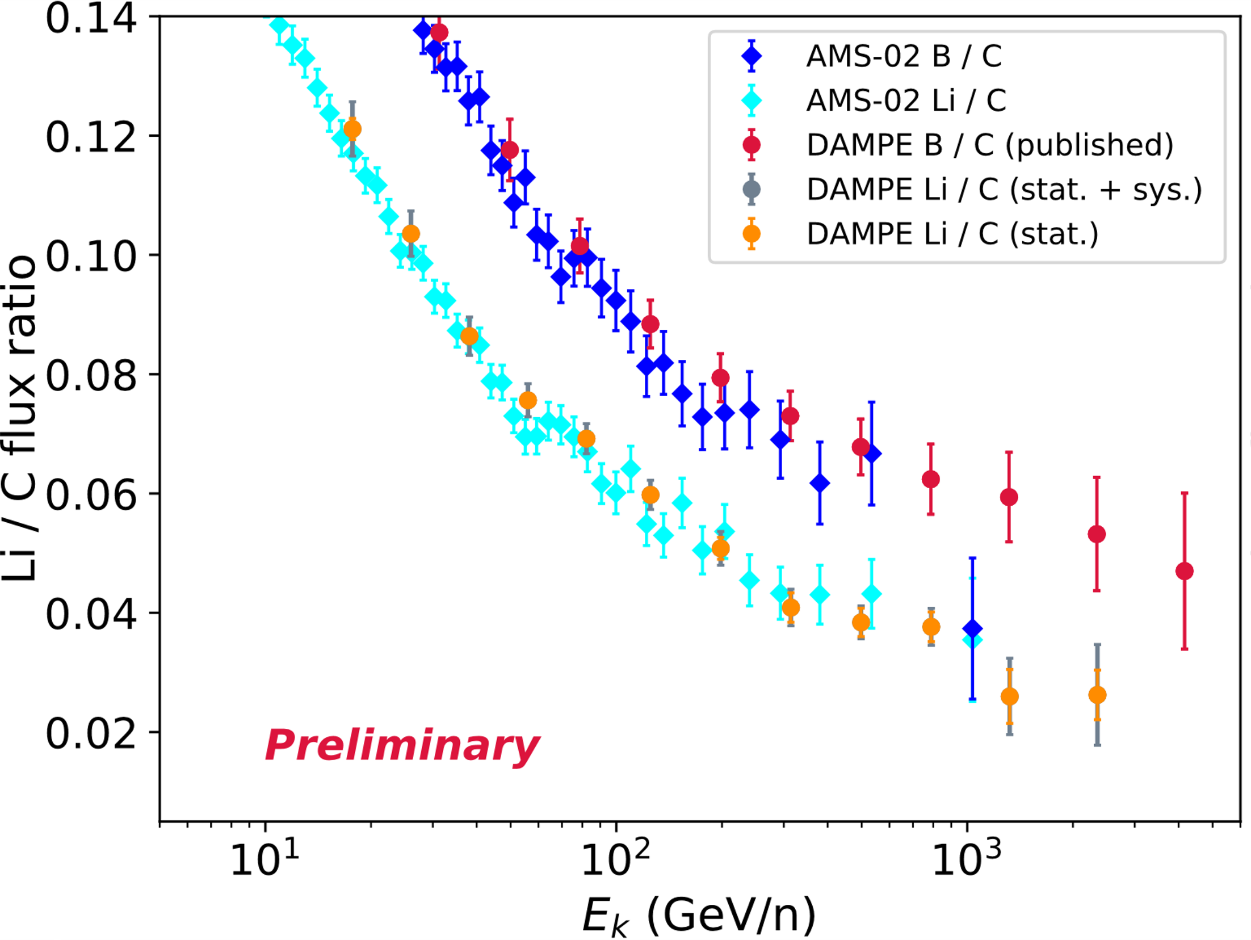
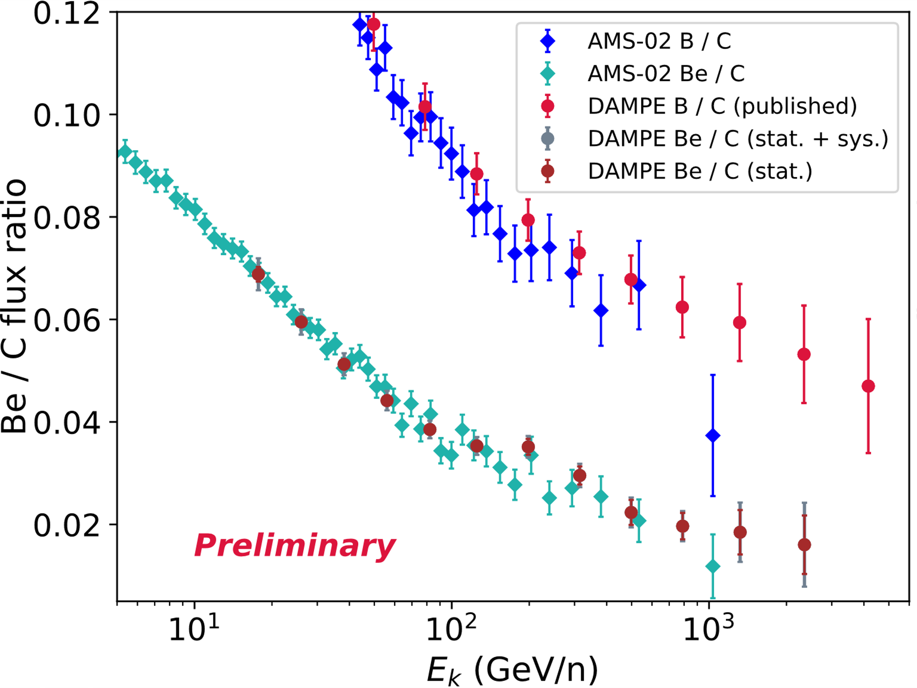
Flux ratios
Li6: Li7 = 1 : 1
Preliminary measurement of Li/C and Be/C from 14.7 GeV/n to 3.2 TeV/n
Preliminary estimation of systematic uncertainty
Further reduction of the background is in progress

Slide 12
Conclusion
Study of Secondary Cosmic Rays:
  Essential for understanding propagation in the Galaxy and CR spectra origins.
Boron Analysis:
  Full sample selection and systematics evaluation
  Preliminary spectrum: 10 GeV/n to 3.2 TeV/n.
Lithium and Beryllium:
  Full sample selection
  Preliminary Li/B and Be/B ratios: 14.7 GeV/n to 3.2 TeV/n.
  Preliminary Li/C and Be/C ratios: 14.7 GeV/n to 3.2 TeV/n.

Slide 13
Backup

Slide 14
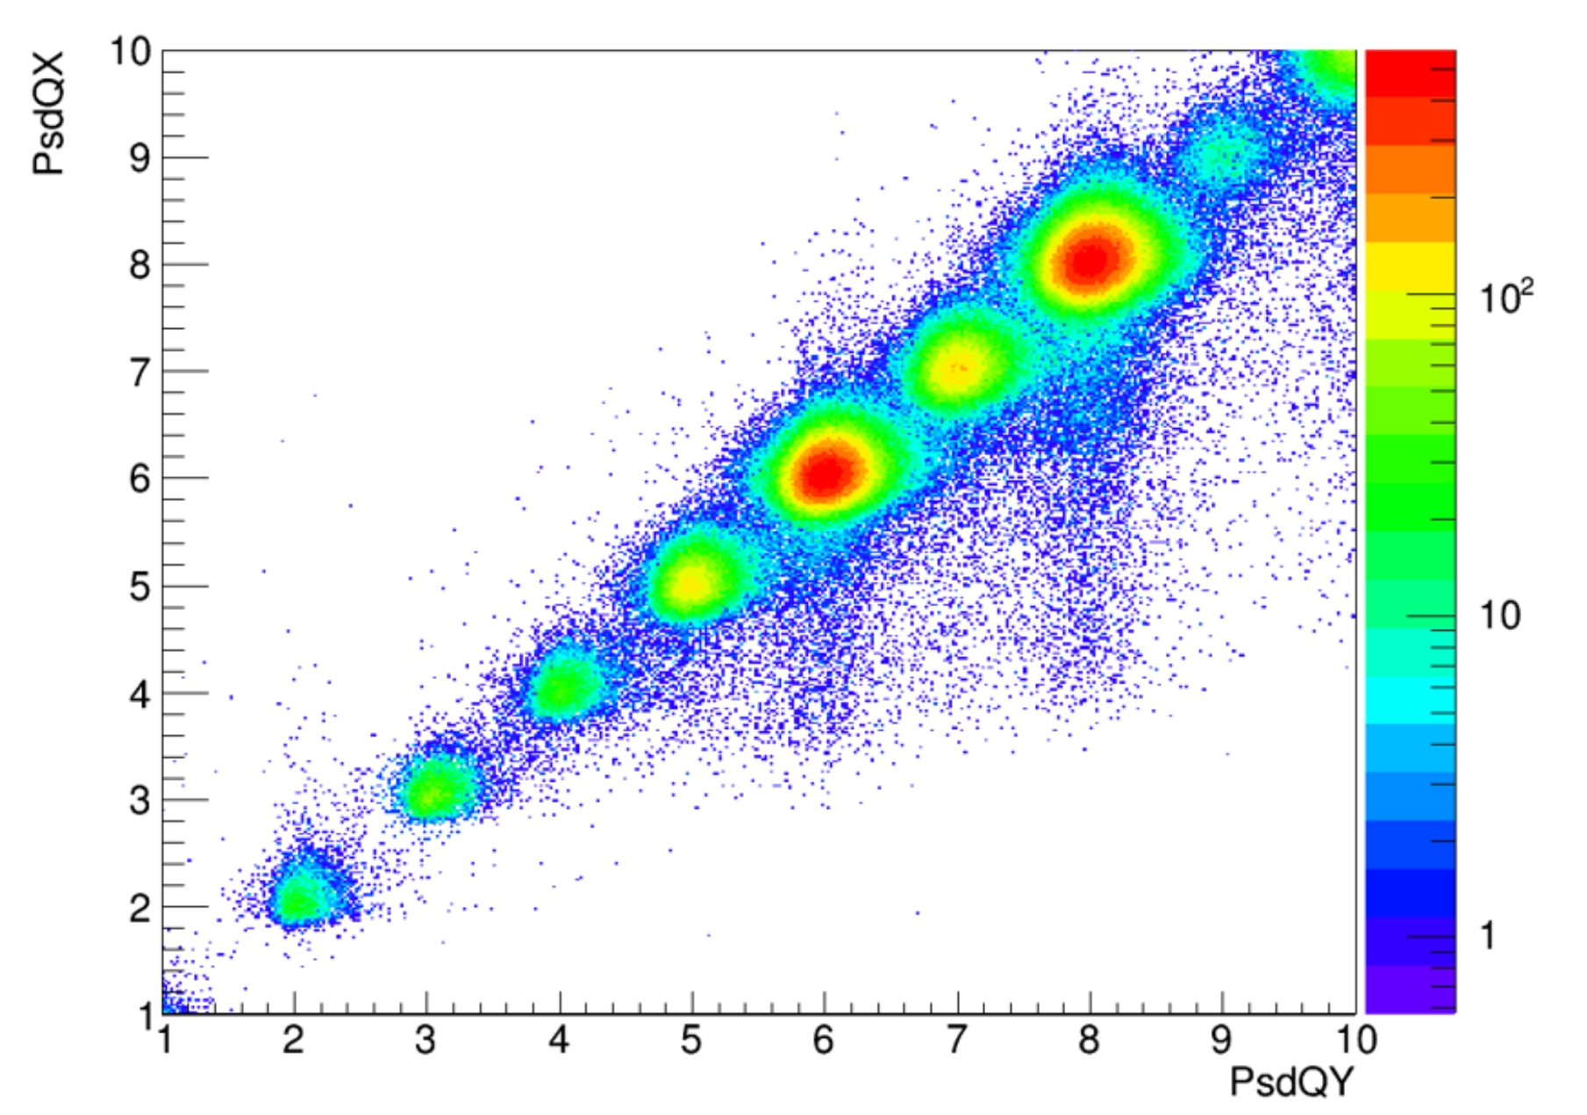
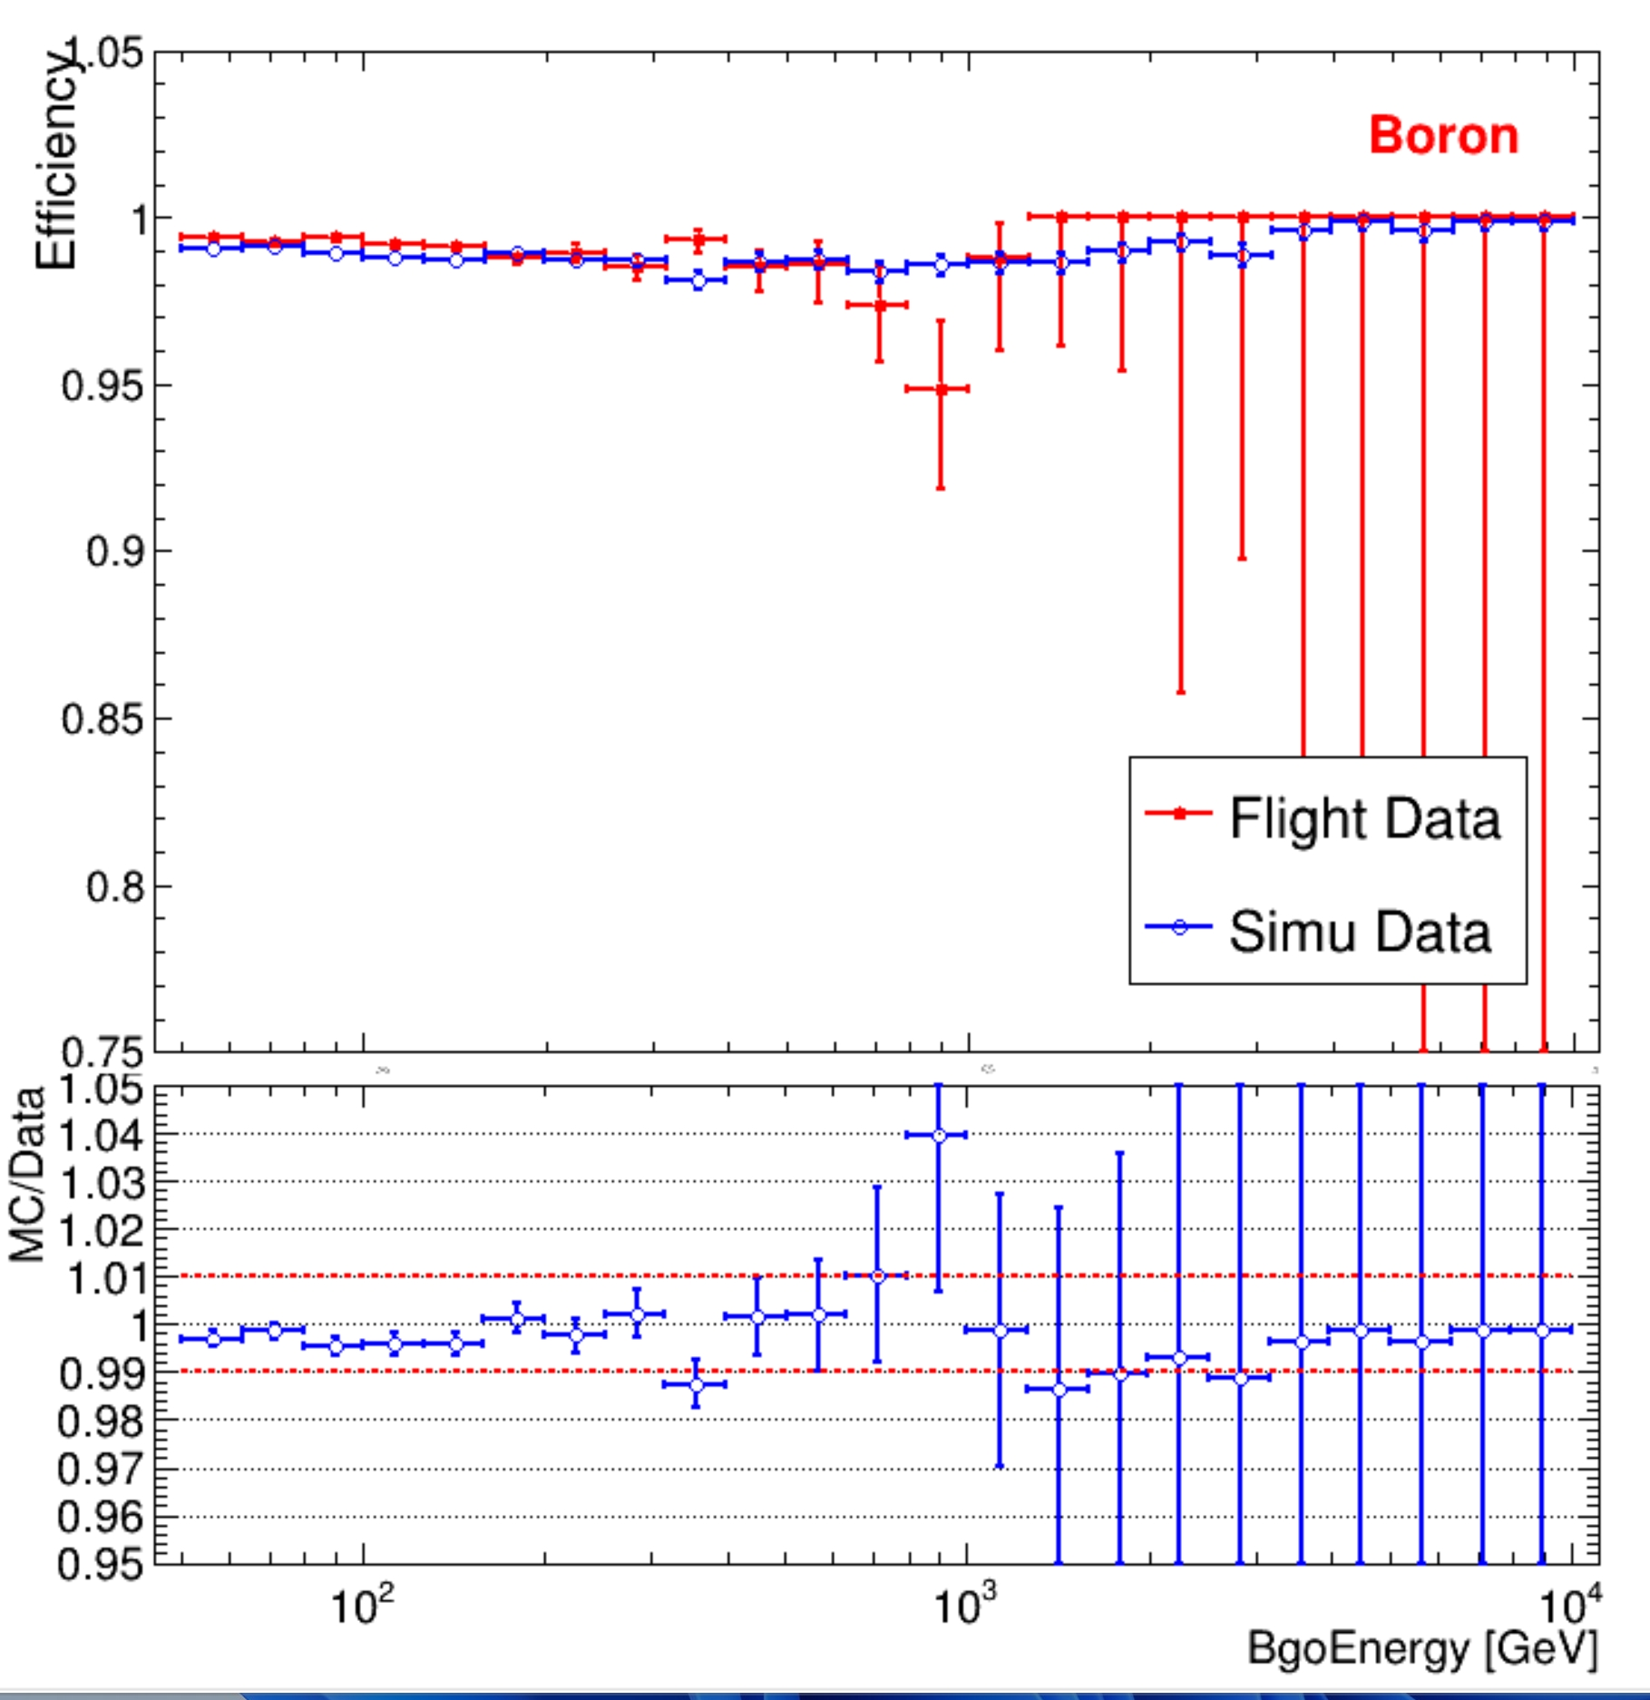
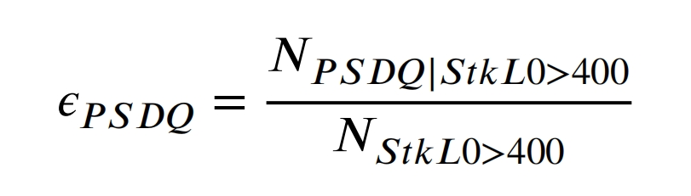
Efficiency
Selecting "pure" Boron events for efficiency calibration
O
N
PSD Efficiency
C
B
Be
Li
He
Boron Charge Selection Uncertainty:
PSD: ~1.0%

Slide 15
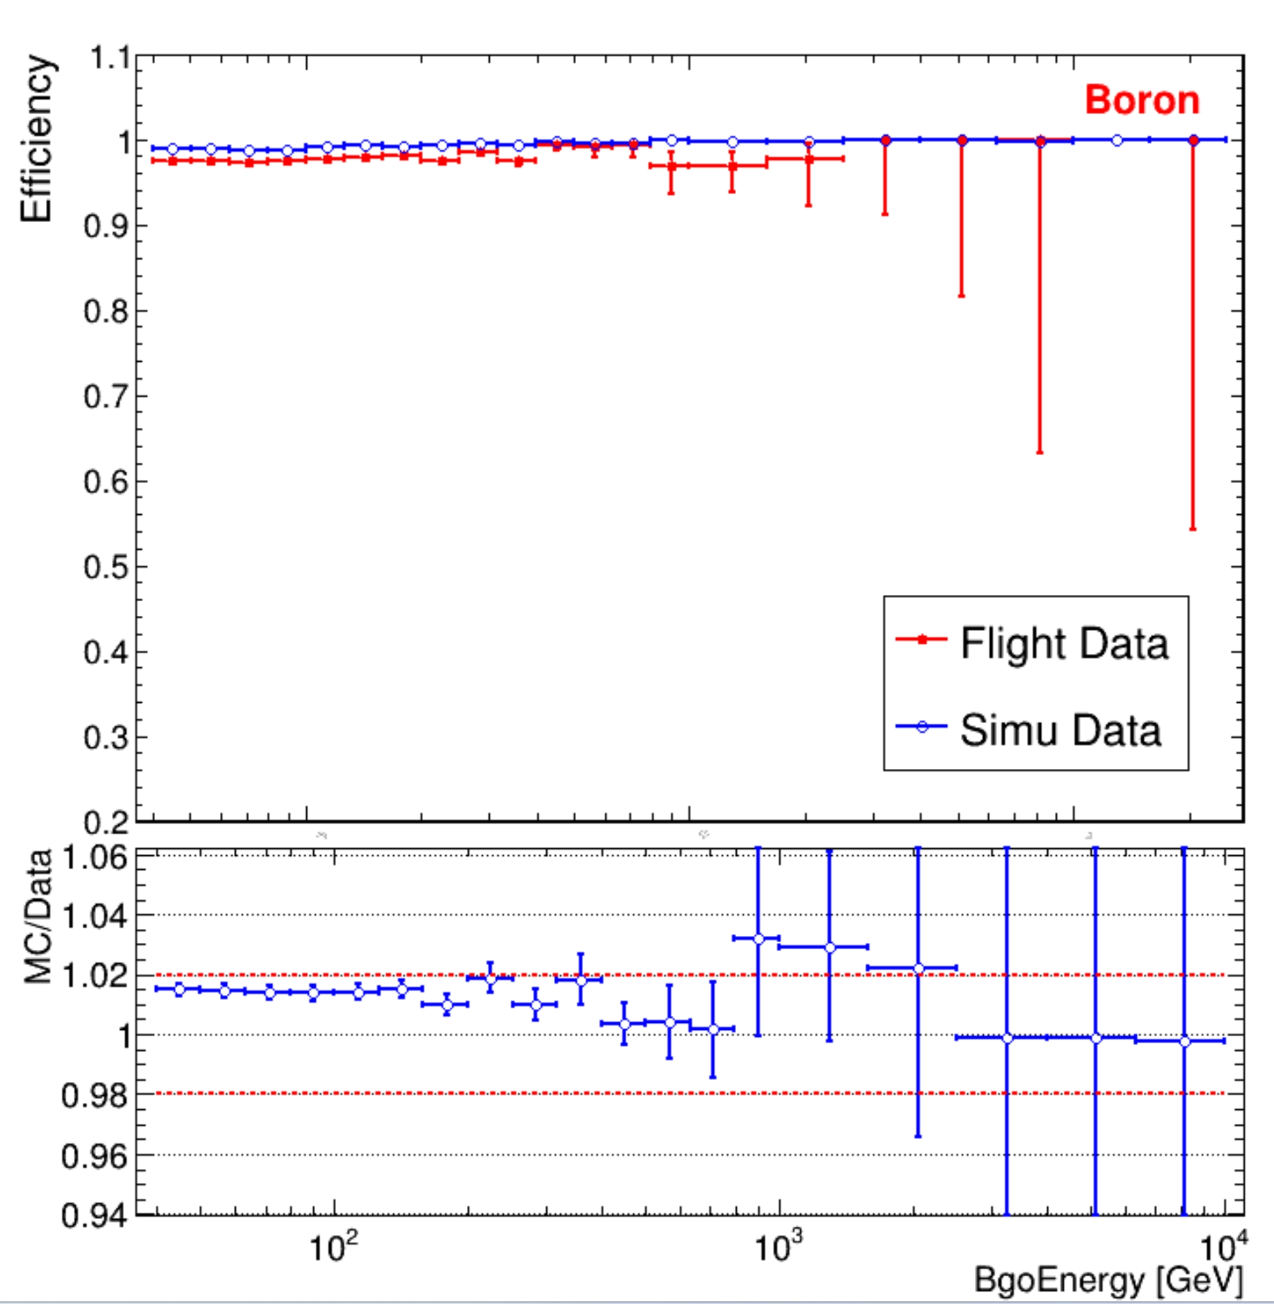
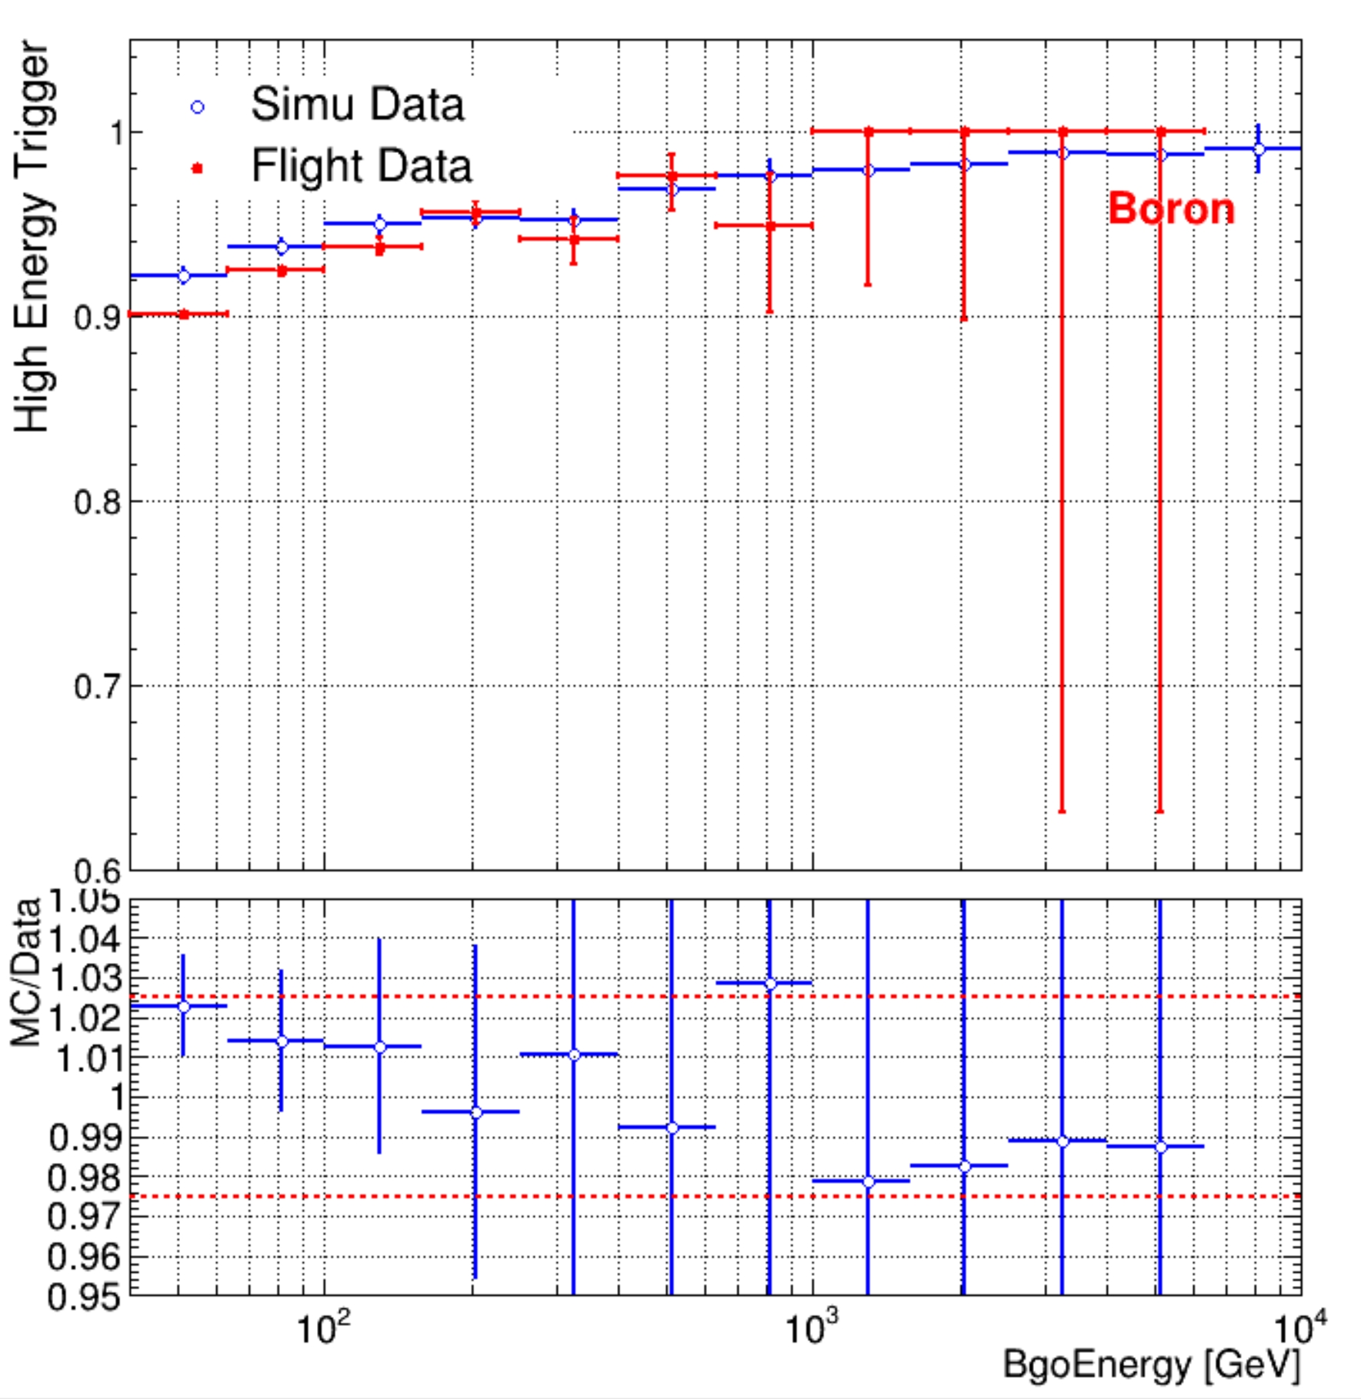
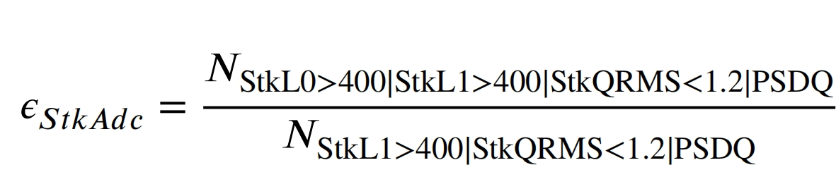
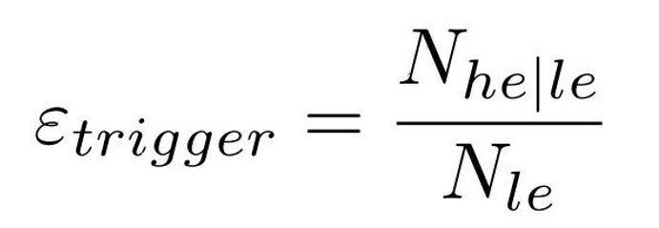
Efficiency
STK Efficiency
HE Trigger Efficiency
Boron Charge Selection Uncertainty :
STK: ~2.0%
HE Trigger: ~2.5%
STK:
HE Trigger：

Slide 16
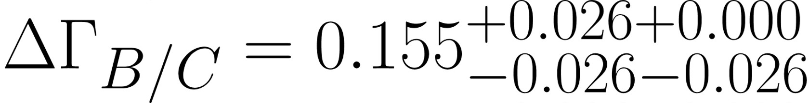
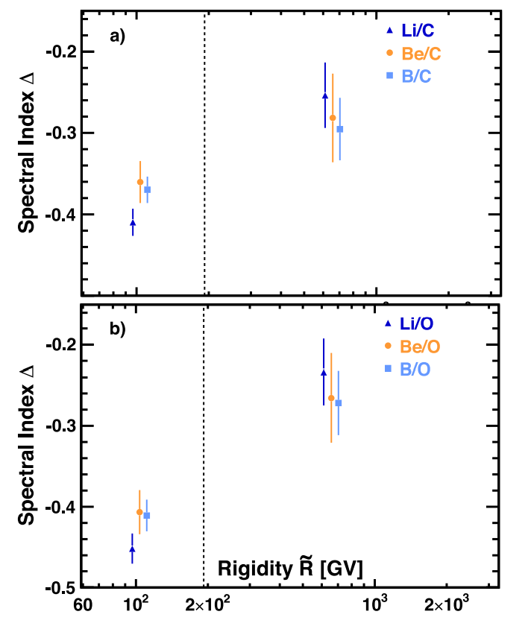
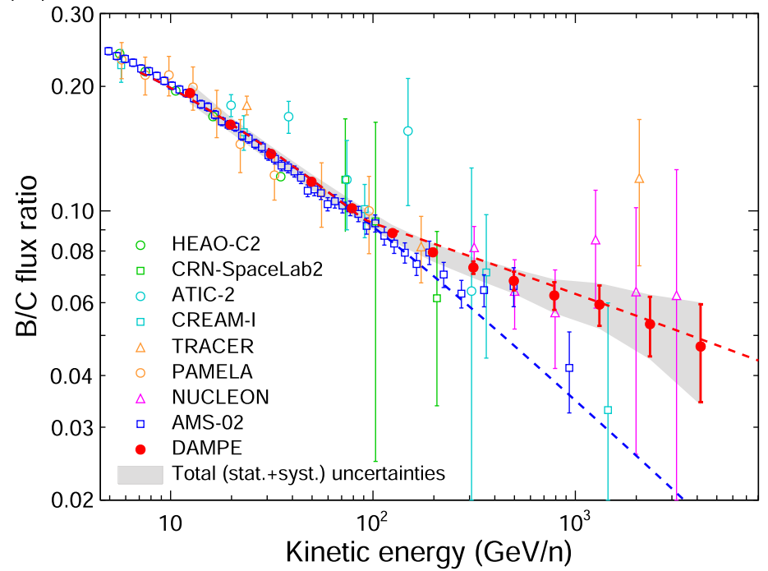
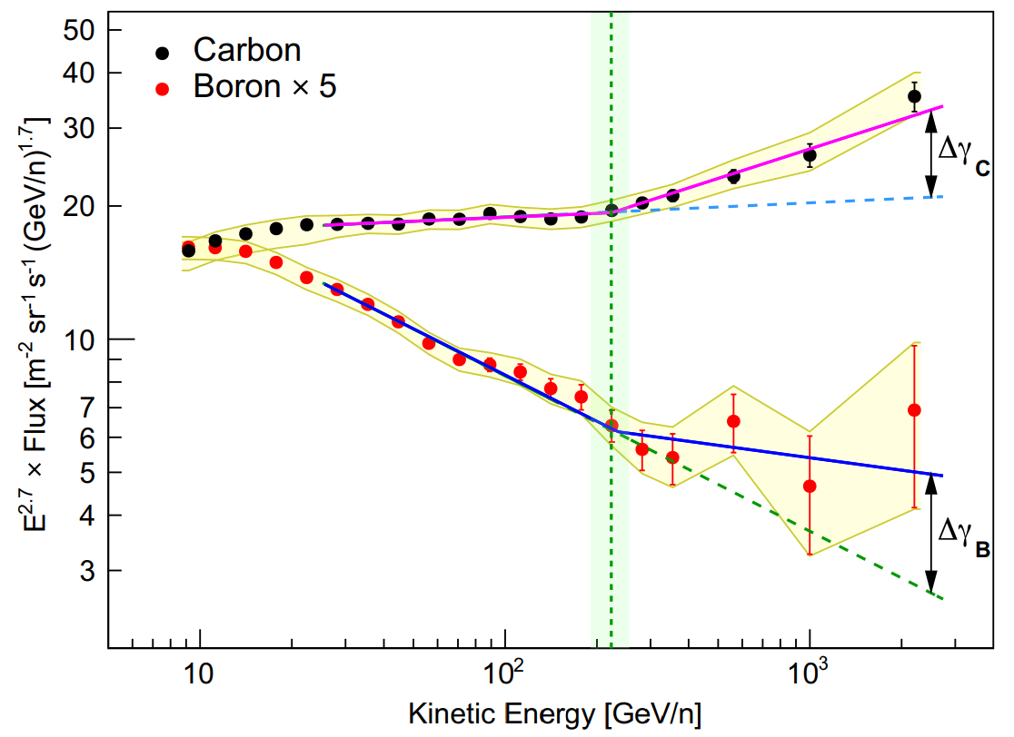
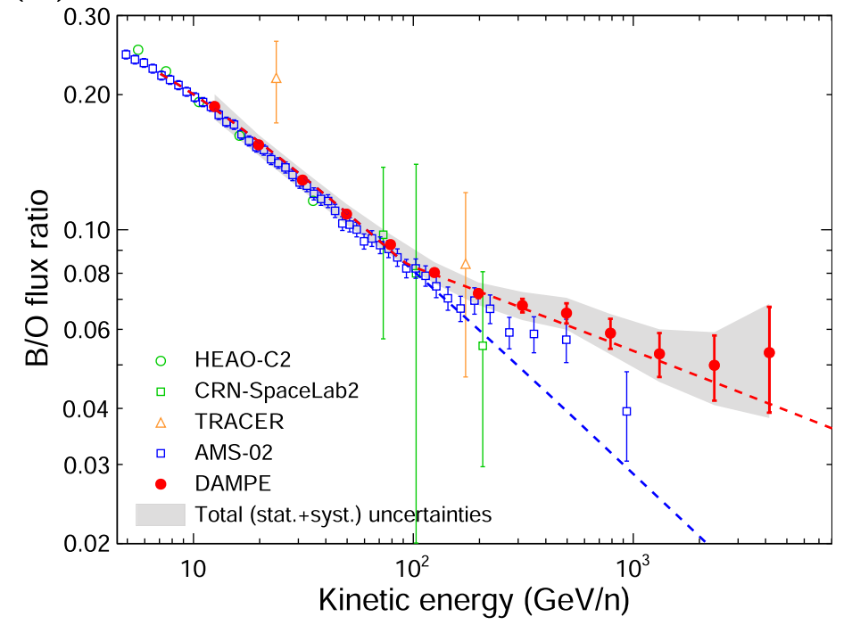
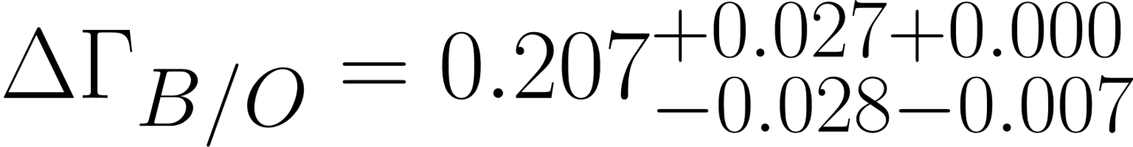



Secondary to primary ratios
AMS-02
DAMPE
CALET
CALET collab., Phys. Rev. Lett. 129 251103 (2022)
M. Aguilar et al, Phys. Rept. 894 1 (2021)
DAMPE collab., Sci. Bull. 67 2162 (2022)
DAMPE analysis

